Slide 1
Christmas in Poland

Slide 2
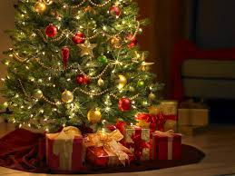
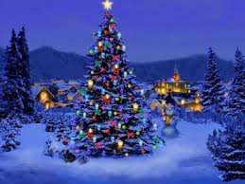
Christmas tree
Christmas tree is our tradition. We decorate it the day before Christmas Eve.

Slide 3
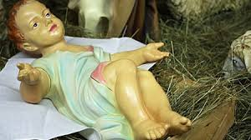
Christmas Eve
It is a ceremony dinner in honor of the child Jesus. On that day the whole family get together and celebrate the birth of Jesus.

Slide 4
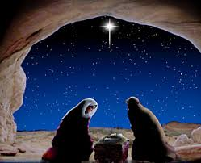
First star
When in the sky is the first star, the family can begin Christmas Eve dinner.

Slide 5
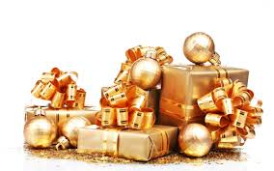
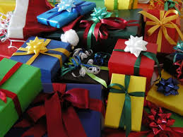
Gifts
When we dress up the Christmas tree, the Child Jesus will come unnoticed and leave presents under the beautiful Christmas tree.

Slide 6
Cover for the unexpected guest
According to the tradition, at the Christmas table, people leave one cover for unexpected guest.

Slide 7
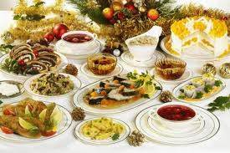
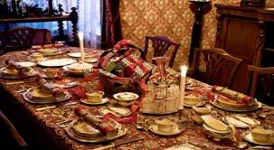
Twelve dishes
Tradition says, at the Christmas table we should put twelve dishes.

Slide 8
Thank You For Watching

